Slide 1
Vaccine Distribution Decision-Aid Model
T7 Consulting
Chloe,Mia,Vidhi,Abhijay,Marcell | DataXP
Notes:
Introduction. Say hello and provide 10 second intro per person
Transition to today’s presentation overview. Here’s what to expect today.

Slide 2
Overview
Context
Vaccine Index Score
Recommendation: Country
Recommendation: Vaccine
Q&A
Notes:
Overview of presentation.

Slide 3
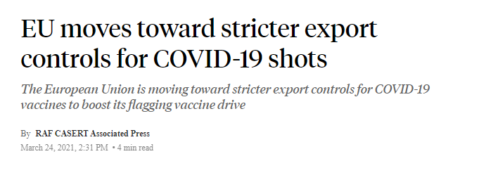
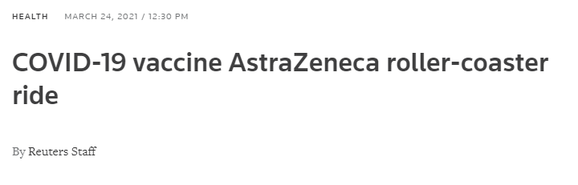
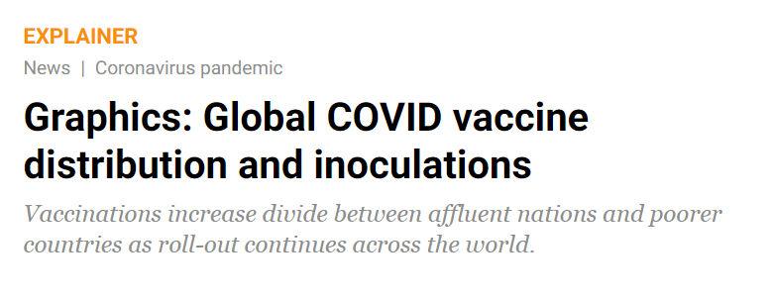
T7 | Context
Notes:
Set context for the project. A year into global pandemic. Challenges in vaccine distribution: changing environment, vaccine safety and perception, vaccine distribution equity.
Relate to QuickJab questions. T7 is happy to support QuickJab’s decision-making process on vaccine distribution: where to distribute and which vaccine.
EU moves toward stricter export controls for COVID-19 shots (ABC News, 2021)
COVID-19 vaccine AstraZeneca roller-coaster ride (Reuters, 2021)
Graphics: Global COVID vaccine distribution and inoculations (Al Jazeera, 2021)

Slide 4
Which vaccine should QuickJab distribute next and where?
T7 | Context
Notes:
Set context for the project. A year into global pandemic. Challenges in vaccine distribution: changing environment, vaccine safety and perception, vaccine distribution equity.
Relate to QuickJab questions. T7 is happy to support QuickJab’s decision-making process on vaccine distribution: where to distribute and which vaccine.
EU moves toward stricter export controls for COVID-19 shots (ABC News, 2021)
COVID-19 vaccine AstraZeneca roller-coaster ride (Reuters, 2021)
Graphics: Global COVID vaccine distribution and inoculations (Al Jazeera, 2021)

Slide 5
Index Score Example: COVID-19 Symptoms
fever
doctor visit
cough
T7 | Vaccine Index Score
taste loss
Notes:
Introduce index score. Imagine that a year ago, you needed to decide whether you should go see a doctor or not. This is when testing was not readily available. You have to wade through uncertainty and make your best judgment. You notice that you have a high fever, coughs, and a sudden loss of taste. Because you know that a high fever and a cough are symptoms that are similar to the seasonal flu or a cold, you may weigh those facts relatively low, compared to the sudden loss of taste, which you weigh quite heavily in your overall decision. This logic is the overall logic behind using an index score. You take into account different sources of information and weigh them accordingly to make your decision. We created a custom index for QuickJab to assist with your decision-making process.

Slide 6
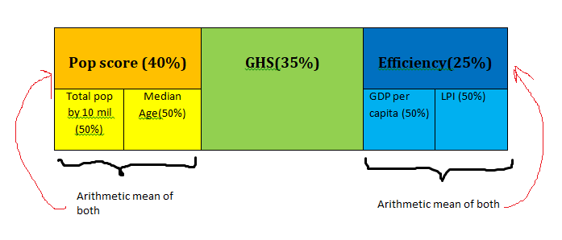
T7 Index
Population Score 40%
median age (CIA Factbook, 2020) ✔️ total population (Google, 2020) ✔️
Global Health Security 35%
Efficiency Score 25%
T7 | Vaccine Index Score
total pop by 10M 50%
median age 50%
GDP per capita 50%
LPI 50%
arithmetic mean
arithmetic mean
Notes:
We can use both: GDP/Capita and LPI.
GDP/Capita effectively tells us the paying capacity of a country. The more the better, as QuickJab can levy more charge / dose.
Let's take a very simplistic scenario:
We have zeroed in South Africa, and Mexico and they have 1000, 1500 USD as their GDP/Capita respectively.
I as a consultant would recommend my client to go for Mexico as Mexico is better off to pay for their vaccines, and maybe they can levy 1 or 2 extra dollars/dosage.
Now, coming back to LPI, reason why I am emphasizing on it is because:
(i) Its a comprehensive score estimated by World Bank taking in consideration the following metrics:
1. Efficiency of the clearance process: speed, simplicity and predictability
of formalities by gov
2. Quality of trade and transport related infrastructure (as in ports,
railroads, roads, information technology)
3. Ease of arranging competitively priced shipment
4. Ability to track and trace consignments
5. Timeliness of shipments in reaching destination within the scheduled
or expected delivery time.
^ I believe there is no metric/scorecard which we have considered which comprehensively demonstrates the comparative performance of almost all the major economies.
(ii) I believe no team has employed this, So it's a differentiating factor as well

Slide 7
T7 Index
Population Score 40%
Global Health Security 35%
Efficiency Score 25%
GHS (Johns Hopkins University, 2019) ✔️
T7 | Vaccine Index Score
total pop by 10M 50%
median age 50%
GDP per capita 50%
LPI 50%
arithmetic mean
arithmetic mean
Notes:
We can use both: GDP/Capita and LPI.
GDP/Capita effectively tells us the paying capacity of a country. The more the better, as QuickJab can levy more charge / dose.
Let's take a very simplistic scenario:
We have zeroed in South Africa, and Mexico and they have 1000, 1500 USD as their GDP/Capita respectively.
I as a consultant would recommend my client to go for Mexico as Mexico is better off to pay for their vaccines, and maybe they can levy 1 or 2 extra dollars/dosage.
Now, coming back to LPI, reason why I am emphasizing on it is because:
(i) Its a comprehensive score estimated by World Bank taking in consideration the following metrics:
1. Efficiency of the clearance process: speed, simplicity and predictability
of formalities by gov
2. Quality of trade and transport related infrastructure (as in ports,
railroads, roads, information technology)
3. Ease of arranging competitively priced shipment
4. Ability to track and trace consignments
5. Timeliness of shipments in reaching destination within the scheduled
or expected delivery time.
^ I believe there is no metric/scorecard which we have considered which comprehensively demonstrates the comparative performance of almost all the major economies.
(ii) I believe no team has employed this, So it's a differentiating factor as well

Slide 8
T7 Index
GDP per capita & LPI (World Bank, 2020) ✔️
Population Score 40%
Global Health Security 35%
Efficiency Score 25%
T7 | Vaccine Index Score
total pop by 10M 50%
median age 50%
GDP per capita 50%
LPI 50%
arithmetic mean
arithmetic mean
Notes:
We can use both: GDP/Capita and LPI.
GDP/Capita effectively tells us the paying capacity of a country. The more the better, as QuickJab can levy more charge / dose.
Let's take a very simplistic scenario:
We have zeroed in South Africa, and Mexico and they have 1000, 1500 USD as their GDP/Capita respectively.
I as a consultant would recommend my client to go for Mexico as Mexico is better off to pay for their vaccines, and maybe they can levy 1 or 2 extra dollars/dosage.
Now, coming back to LPI, reason why I am emphasizing on it is because:
(i) Its a comprehensive score estimated by World Bank taking in consideration the following metrics:
1. Efficiency of the clearance process: speed, simplicity and predictability
of formalities by gov
2. Quality of trade and transport related infrastructure (as in ports,
railroads, roads, information technology)
3. Ease of arranging competitively priced shipment
4. Ability to track and trace consignments
5. Timeliness of shipments in reaching destination within the scheduled
or expected delivery time.
^ I believe there is no metric/scorecard which we have considered which comprehensively demonstrates the comparative performance of almost all the major economies.
(ii) I believe no team has employed this, So it's a differentiating factor as well

Slide 9
T7 Index
Population Score 40%
Global Health Security 35%
Efficiency Score 25%
T7 | Vaccine Index Score
total pop by 10M 50%
median age 50%
GDP per capita 50%
LPI 50%
arithmetic mean
arithmetic mean
Notes:
We can use both: GDP/Capita and LPI.
GDP/Capita effectively tells us the paying capacity of a country. The more the better, as QuickJab can levy more charge / dose.
Let's take a very simplistic scenario:
We have zeroed in South Africa, and Mexico and they have 1000, 1500 USD as their GDP/Capita respectively.
I as a consultant would recommend my client to go for Mexico as Mexico is better off to pay for their vaccines, and maybe they can levy 1 or 2 extra dollars/dosage.
Now, coming back to LPI, reason why I am emphasizing on it is because:
(i) Its a comprehensive score estimated by World Bank taking in consideration the following metrics:
1. Efficiency of the clearance process: speed, simplicity and predictability
of formalities by gov
2. Quality of trade and transport related infrastructure (as in ports,
railroads, roads, information technology)
3. Ease of arranging competitively priced shipment
4. Ability to track and trace consignments
5. Timeliness of shipments in reaching destination within the scheduled
or expected delivery time.
^ I believe there is no metric/scorecard which we have considered which comprehensively demonstrates the comparative performance of almost all the major economies.
(ii) I believe no team has employed this, So it's a differentiating factor as well

Slide 10
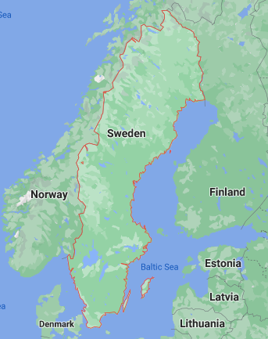
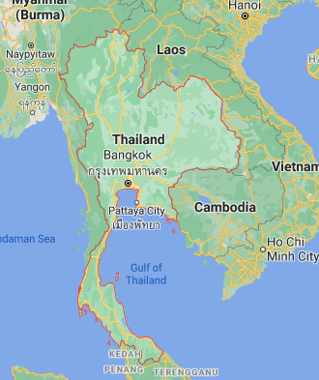
Sweden - High Income
Thailand - Medium Income
Country recommendation
T7 | Recommendation: Country
Notes:
Set context for the project. A year into global pandemic. Challenges in vaccine distribution: changing environment, vaccine safety and perception, vaccine distribution equity.
Relate to QuickJab questions. T7 is happy to support QuickJab’s decision-making process on vaccine distribution: where to distribute and which vaccine.
EU moves toward stricter export controls for COVID-19 shots (ABC News, 2021)
COVID-19 vaccine AstraZeneca roller-coaster ride (Reuters, 2021)
Graphics: Global COVID vaccine distribution and inoculations (Al Jazeera, 2021)

Slide 11
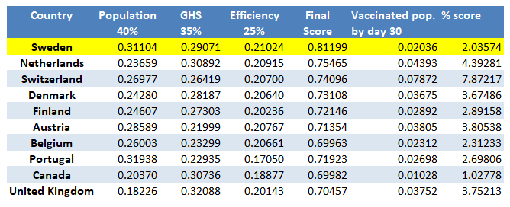
Sweden - High Income
Country recommendation
T7 | Recommendation: Country
Notes:
Set context for the project. A year into global pandemic. Challenges in vaccine distribution: changing environment, vaccine safety and perception, vaccine distribution equity.
Relate to QuickJab questions. T7 is happy to support QuickJab’s decision-making process on vaccine distribution: where to distribute and which vaccine.
EU moves toward stricter export controls for COVID-19 shots (ABC News, 2021)
COVID-19 vaccine AstraZeneca roller-coaster ride (Reuters, 2021)
Graphics: Global COVID vaccine distribution and inoculations (Al Jazeera, 2021)

Slide 12
The Best Vaccine?
N O N E !
T7 | Recommendation: Vaccine
Notes:
Set context for the project. A year into global pandemic. Challenges in vaccine distribution: changing environment, vaccine safety and perception, vaccine distribution equity.
Relate to QuickJab questions. T7 is happy to support QuickJab’s decision-making process on vaccine distribution: where to distribute and which vaccine.

Slide 13

No Infection
Death
Hospitalized
Severe Symptoms
Moderate
Symptoms
No Symptoms
T7 | Recommendation: Vaccine
Notes:
Set context for the project. A year into global pandemic. Challenges in vaccine distribution: changing environment, vaccine safety and perception, vaccine distribution equity.
Relate to QuickJab questions. T7 is happy to support QuickJab’s decision-making process on vaccine distribution: where to distribute and which vaccine.
EU moves toward stricter export controls for COVID-19 shots (ABC News, 2021)
COVID-19 vaccine AstraZeneca roller-coaster ride (Reuters, 2021)
Graphics: Global COVID vaccine distribution and inoculations (Al Jazeera, 2021)

Slide 14
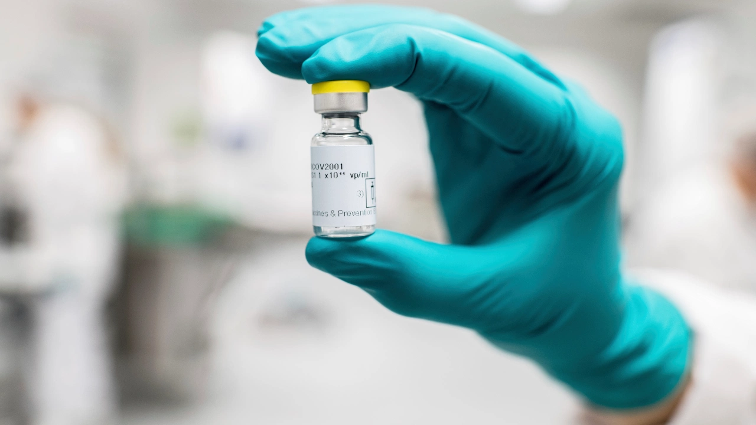
Johnson & Johnson: Competitive Advantages
Single dose
Least expensive
Refrigerator temperature storage
T7 | Recommendation: Vaccine
Notes:
Set context for the project. A year into global pandemic. Challenges in vaccine distribution: changing environment, vaccine safety and perception, vaccine distribution equity.
Relate to QuickJab questions. T7 is happy to support QuickJab’s decision-making process on vaccine distribution: where to distribute and which vaccine.
EU moves toward stricter export controls for COVID-19 shots (ABC News, 2021)
COVID-19 vaccine AstraZeneca roller-coaster ride (Reuters, 2021)
Graphics: Global COVID vaccine distribution and inoculations (Al Jazeera, 2021)

Slide 15
Questions
& Answers
T7 Consulting
Chloe,Mia,Vidhi,Abhijay,Marcell | DataXP
Notes:
Q&A and close. Transition to Q&A and close out with thanks and goodbye

Slide 16
Appendix
Notes:
Q&A and close. Transition to Q&A and close out with thanks and goodbye

Slide 17
Key Formulas
Scoring Formula = Actual - Min / Max - Min | ln(Actual) - ln(Min)/ ln(Max) - ln(Min) Weighted Score = Score x Weights
T7 | Appendix A. Index Formula

Slide 18
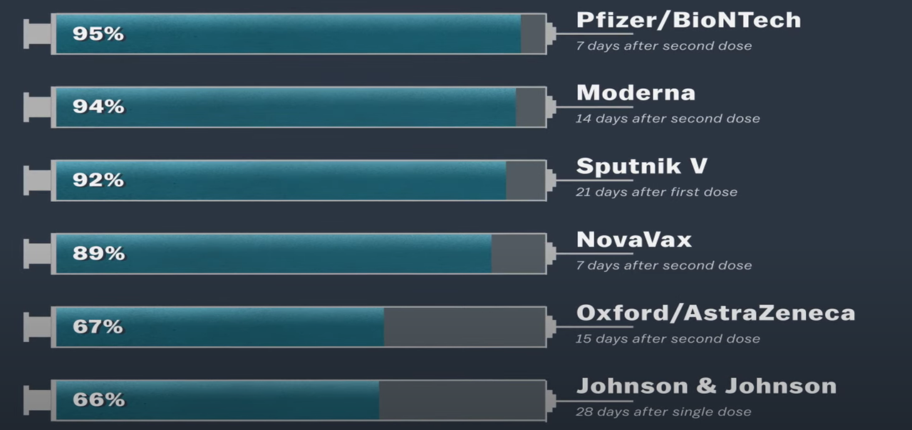
Efficacy Rates of Covid-19 Vaccines
in clinical trials
T7 | Appendix B. Efficacy Rates
Notes:
Set context for the project. A year into global pandemic. Challenges in vaccine distribution: changing environment, vaccine safety and perception, vaccine distribution equity.
Relate to QuickJab questions. T7 is happy to support QuickJab’s decision-making process on vaccine distribution: where to distribute and which vaccine.
EU moves toward stricter export controls for COVID-19 shots (ABC News, 2021)
COVID-19 vaccine AstraZeneca roller-coaster ride (Reuters, 2021)
Graphics: Global COVID vaccine distribution and inoculations (Al Jazeera, 2021)

Slide 19
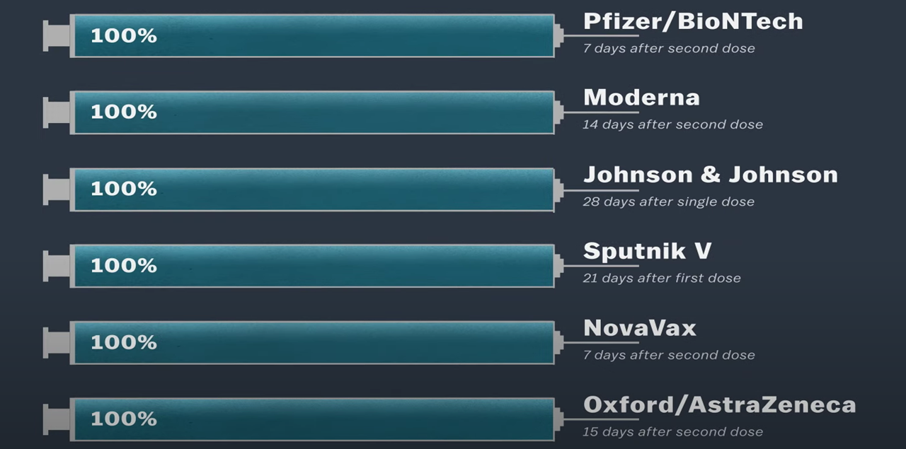
Efficacy Against Death & Hospitalization
T7 | Appendix B. Efficacy Rates
Notes:
Set context for the project. A year into global pandemic. Challenges in vaccine distribution: changing environment, vaccine safety and perception, vaccine distribution equity.
Relate to QuickJab questions. T7 is happy to support QuickJab’s decision-making process on vaccine distribution: where to distribute and which vaccine.
EU moves toward stricter export controls for COVID-19 shots (ABC News, 2021)
COVID-19 vaccine AstraZeneca roller-coaster ride (Reuters, 2021)
Graphics: Global COVID vaccine distribution and inoculations (Al Jazeera, 2021)

